Slide 1
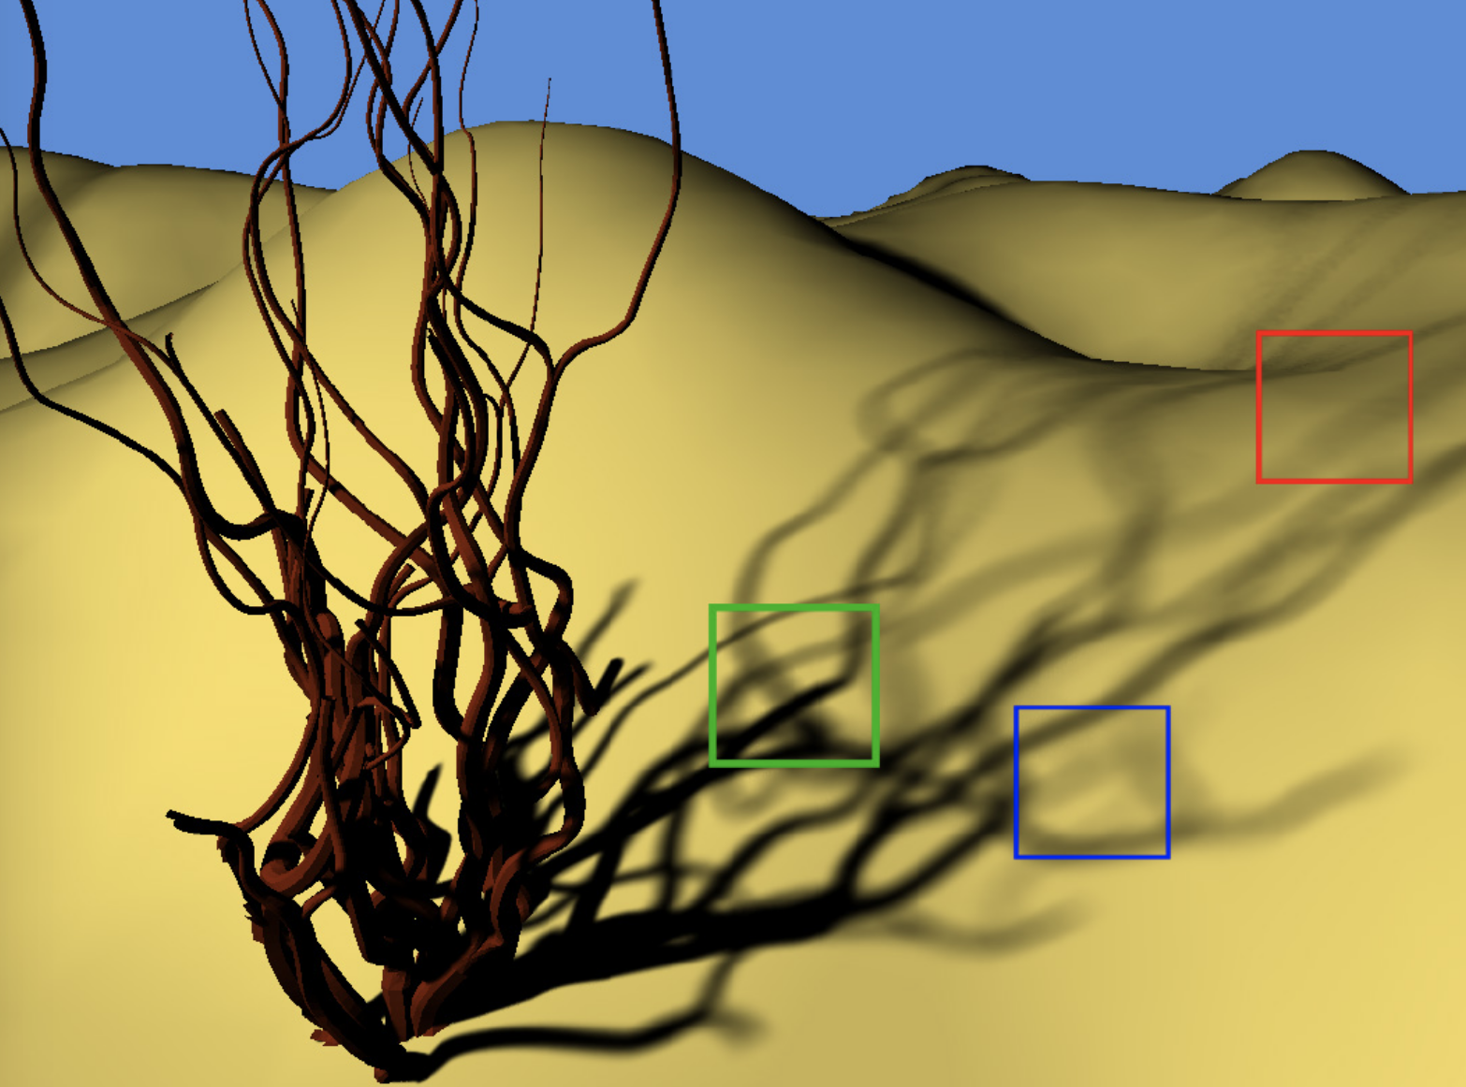
Axis-Aligned Filtering for Interactive Sampled Soft Shadows
Soham Uday Mehta Brandon Wang Ravi Ramamoorthi
University of California, Berkeley
http://cseweb.ucsd.edu/~viscomp/classes/cse274/fa18/papers/a163-mehta.pdf
Notes:
Hello, everyone
My name is Xinming, and today I am going to present the paper
“Axis-aligned filtering for interactive sampled soft shadows”
This paper introduces a novel Monte Carlo based method from frequency analysis and sheared filtering for offline soft shadows for real time use. But essentially , it is a image de-noiser.

Slide 2
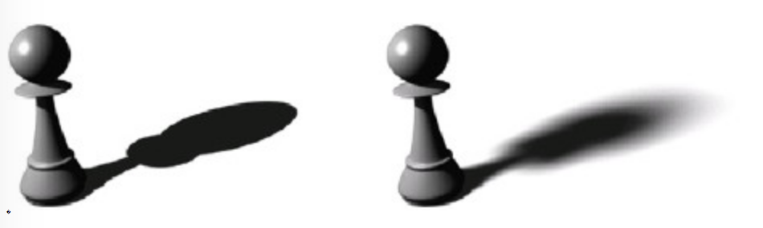
Introduction
http://softimage.wiki.softimage.com/xsidocs/dir_shadows_CreatingSoftShadowswithAreaLights.html
Notes:
Many algorithms have been used to generate soft shadows cast by area light, cause soft shadows are not just zero or one from visibility function, we have to take the integral of all light source. Monte Carlo sampling is the method of choice for producing rendering due to its simplicity and widespread use for offline rendering. However, it is very expensive because every location on the area light must be considered and sampled

Slide 3
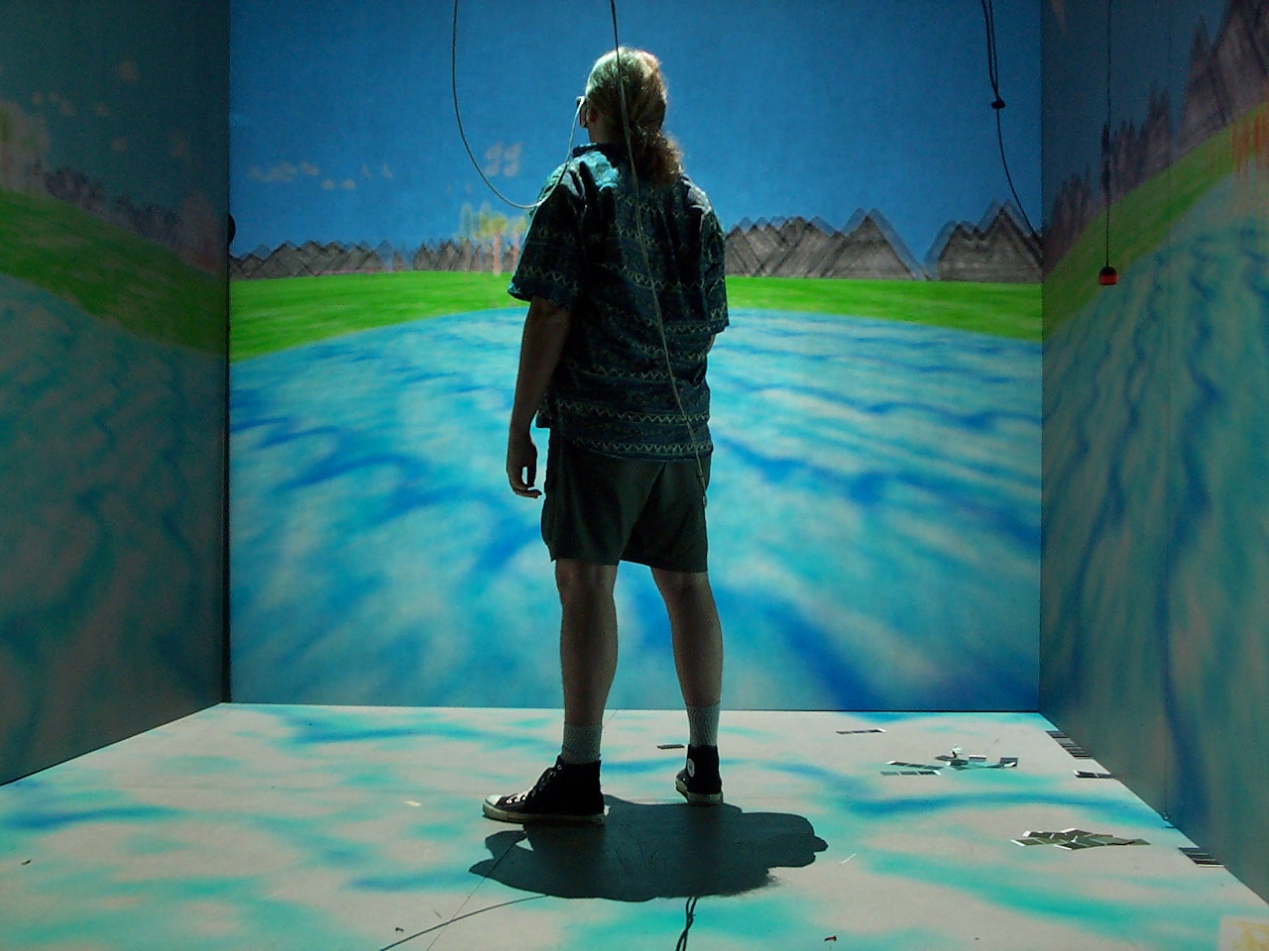
introduction
https://en.wikipedia.org/wiki/Realtime_computer_graphics#/media/File:CAVE_Crayoland.jpg
Notes:
On the other hand, real-time techniques have achieved impressive results, they rely on a variety of approximations, making no guarantee of convergence to ground truth remaining some artifacts
So this paper focus on accurate and efficient rendering of soft shadows

Slide 4

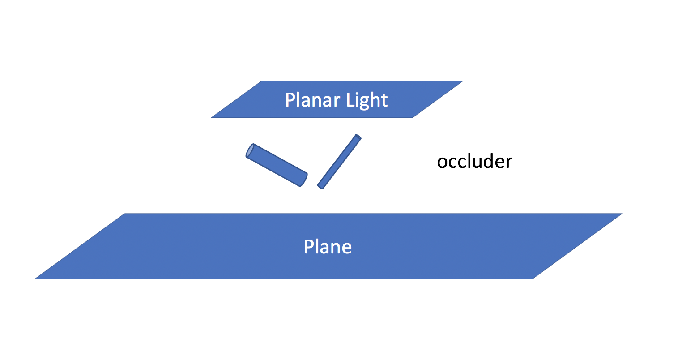
introduction
Build on [Egan et al. 2011b] to significantly reduce the number of Monte Carlo samples needed
Notes:
The paper builds on [Egan et al. 2011b] to significantly reduce the number of Monte Carlo samples needed
while still keeping the benefits of accurate retraced occlusion. It mainly models soft shadows in the scene where there is a planar light and parallel plane, and there are several occluders contained within it.

Slide 5
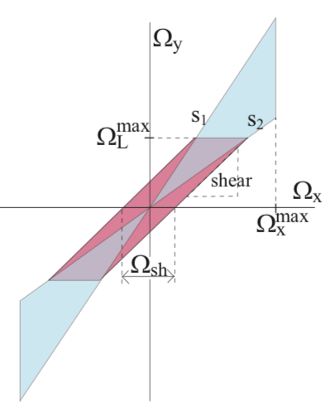
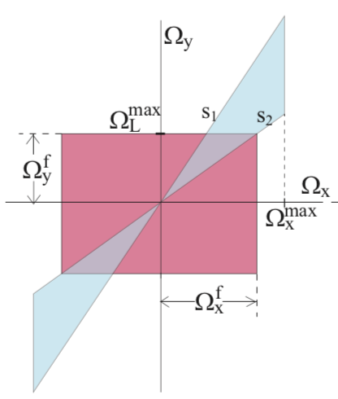
introduction
Build on [Egan et al. 2011b] to significantly reduce the number of Monte Carlo samples needed
http://cseweb.ucsd.edu/~viscomp/classes/cse274/fa18/papers/a163-mehta.pdf
Notes:
It develops an axis-aligned filter in the 4D pixel-light domain referring to the shadow light field. Comparing with sheared filter, axis-aligned filter can reduce considerable overhead of minutes

Slide 6
Overview
Introduction
Previous work
Methods
Axis-aligned filtering
Adaptive sampling
Results
Limitations
Contributions
Future work

Slide 7
Previous
Real-Time and Accelerated Soft Shadows
— Shadow mapping method [Williams 1978]
— Occlusion from entire area source [Guennebaud et al. 2006; Annen et al. 2008]
— An analytic approach based on beam tracing [Overbeck et al. 2007]
Notes:
The shadow mapping method was first introduced by Williams in 1978
And then was extended to occlusion from entire area source by
An analytic approach based on beam tracing [Overbeck et al. 2007]
but is not fast enough for real-time use, especially on complex scenes

Slide 8
Previous
Monte Carlo and Ray-Traced Shadows
— Accelerations that exploit coherence [Hart et al. 1999; Agrawala et al. 2000]
— Separate far and near-field effects [Arikan et al. 2005]
— Prefilter visibility [Lacewell et al. 2008]
— Accelerate ray packets [Benthin and Wald 2009]
— GPU acceleration [Eisemann and Decoret 2007; Forest et al. 2008]
Notes:
A number of accelerations that exploit coherence have been proposed
As well as methods to separate near and far-field effects, prefilter visibility, accelerate ray packets
A few work recent years have explored GPU acceleration of occlusion queries

Slide 9
Previous
Adaptive Sampling and Sheared Reconstruction
— Offline rendering methods [Guo 1998] [Hachisuka et al. 2008] [Overbeck et al. 2009]
— Frequency analysis of shadows and light [Chai et al. 2000; Durand et al. 2005; Lanman et al. 2008]
— Sheared filter [Egan et al. 2011b]
Notes:
The method of this paper is inspired by the offline rendering methods of Guo in 1998 and many other methods in last 10 years
There are some recent approaches for frequency analysis of shadows and light
It mainly builds on the sheared filter proposed by Egan

Slide 10
Overview
Introduction
Previous work
Methods
Axis-aligned filtering
Adaptive sampling
Results
Limitations
Contributions
Future work

Slide 11
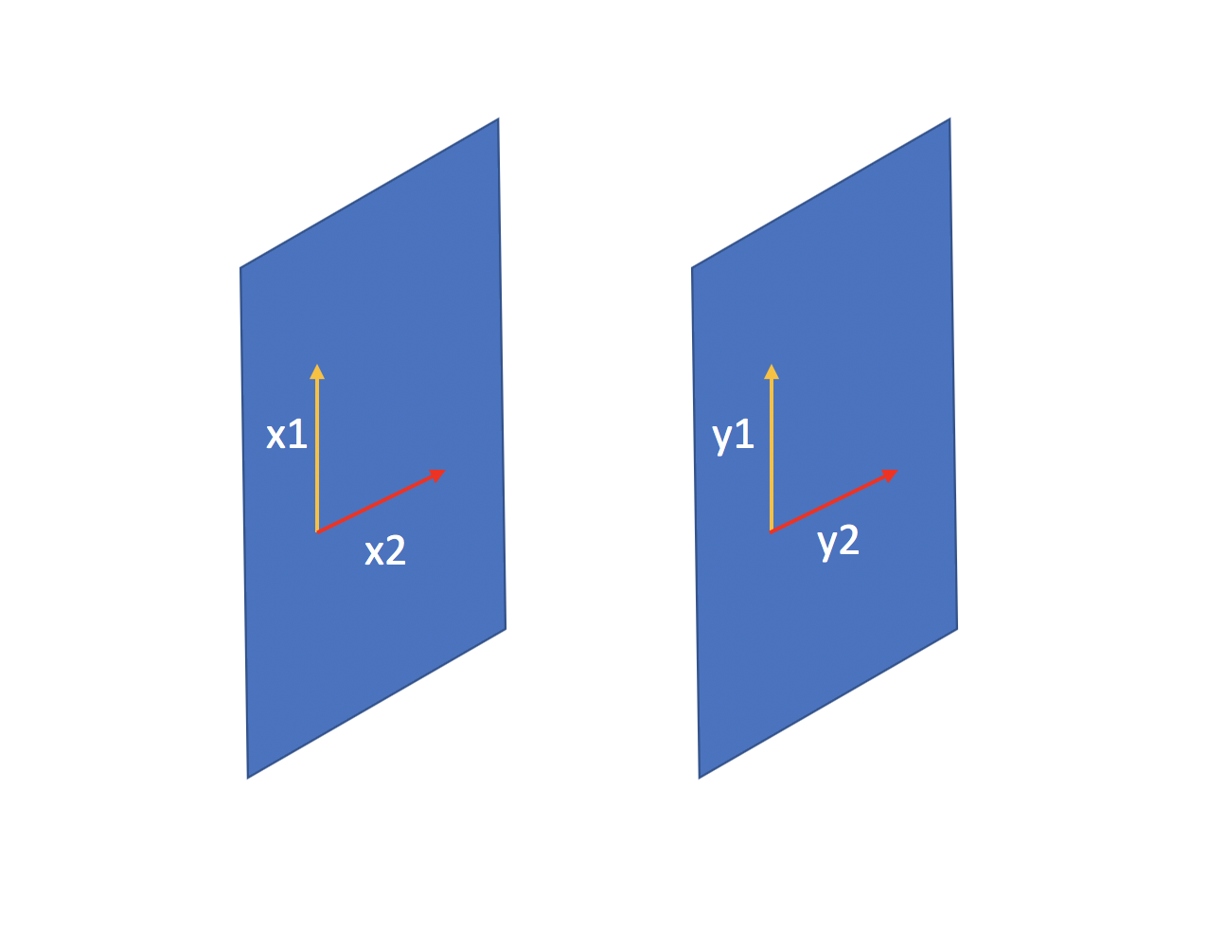
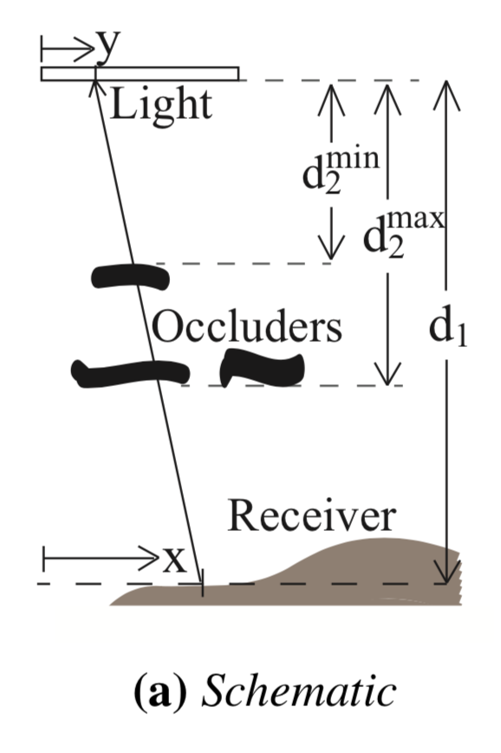
methods
http://cseweb.ucsd.edu/~viscomp/classes/cse274/fa18/papers/a163-mehta.pdf
Notes:
Let’s go back to the scene I’ve mentioned before.
The method is based on 4D light shadow field.
We start our analysis of shadow signal and light field with a simple scene in flatland.
If we take a look at a specific point on the plane, the shadow at that point will actually take the integral of whole light source
-- next
If we view this scene from the side, it will become like this.
It is most natural to use a two-plane (x,y) parameterization, y is the absolute distance along the planar light area, and x is the absolute distance along the plane parallel to the light source
Where the distance from planar light to the current receiver is d1, and the occluding geometry is contained within a depth range of [d2min, d2max].
The analysis is applied to the local extent of a signal pixel, so the algorithm will use a different d1 per pixel and handle nonplanar receiver surfaces.
Essentially, the analysis in flatland is easy to extend to 3D where the light field has four dimensions(x1, x2, y1, y2).
-- next
If we use orthogonal basis vectors to parameterize the area light source, the (x1,y1) subspace is linearly independent of the (x2,y2)
Because of this, most of the computations can be broken down into two separate 2D problems.

Slide 12
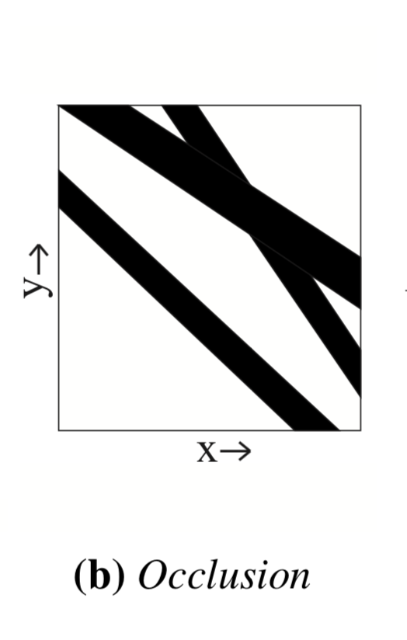
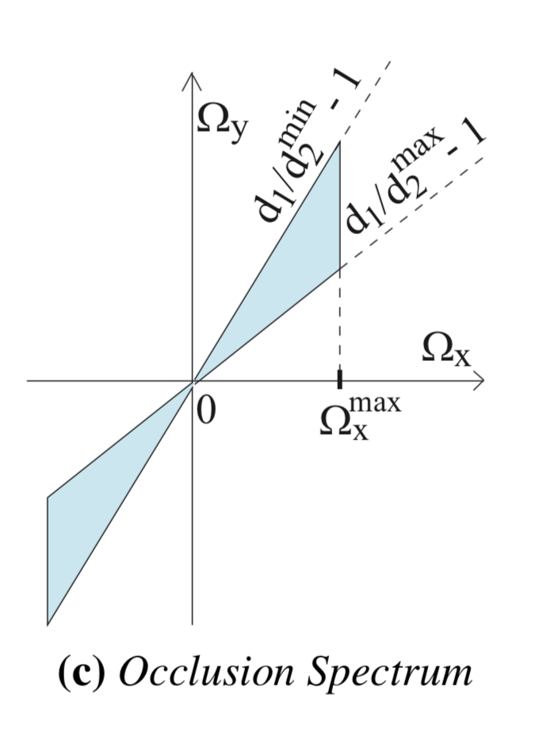
Methods
http://cseweb.ucsd.edu/~viscomp/classes/cse274/fa18/papers/a163-mehta.pdf
Notes:
As for this side view, we can draw the visibility function based on the occluder
--next
For a receiver, if we scan the whole light source, we can get the graph like this
So we can see each occluder creates a diagonally shaped band in the x-y pixel light space, and all bands are multiplied together to get the final visibility function.
If we transform this function into Fourier domain, the frequency spectrum of visibility function F will be like this.
As we can see, the space domain and fourier domain spectrum are orthogonal.
Also, cause the occluder has different depths, so the spectrum will be a wedge shape.

Slide 13
Overview
Introduction
Previous work
Methods
Axis-aligned filtering
Adaptive sampling
Results
Limitations
Contributions
Future work
Notes:
Ok, that’s all for basic idea, what we will do next is to determine the adaptive filter for each pixel and samples per pixel based on this frequency analysis

Slide 14
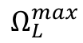

Axis-aligned filtering
Frequency Domain Bandlimits
— Pixel field $Ω_{x}$ : $Ω_{pix}^{max}=1/d$
$Ω_{g}^{max}=Ω_{pix}^{max}$
— Light field$Ω_{y}$ : $Ω_{y}^{max}=(\frac{d1}{d_{2}^{min}}−1)Ω_{x}^{max}$
$Ω_{L}^{max}=(1/σ)m^{−1}$ Gaussian light
$$Ω_{L}^{max}$$
http://cseweb.ucsd.edu/~viscomp/classes/cse274/fa18/papers/a163-mehta.pdf
Notes:
The frequency spectra defines the sampling resolution and hence the filter size.
The axis-aligned here refers to the 2D(later we will extend 4D) pixel-light space, not the 2D image space
First, we need to determine frequency domain bandlimits
Frequencies in both dimensions , Ox, and Oy are in the units of per meter.
The limited resolution of the output image acts as a low pass filter in the pixel dimension.
Omega pixel max is the maximum displayable frequency in the pixel space, and is taken to be (1/d) per meter, where d is the projected distance per pixel.
Also the spectra function is assumed to have a spatial bandlimit imposed due to smoothness of geometry causing the occlusion.
As for Oy, From the geometry, it is clear that Oy = Ox multiply slope
Finally, since effective visibility is the integration of the light intensity with the occlusion function,
frequencies in the occlusion function outside the light’s bandlimit Olmax will be filtered.
And we assume the light is a Gaussian with standard deviation - sigma

Slide 15
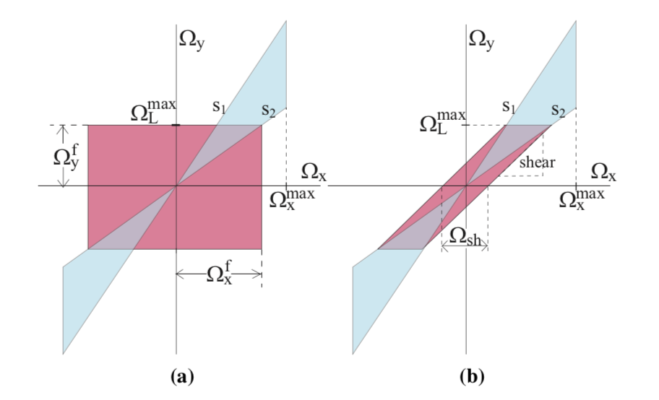


Axis-aligned filtering
Frequency domain filter
$$Ω_{x}^{f}=min⁡[\frac{Ω_{L}^{max}}{s2} ,Ω_{x}^{max}]$$
$$Ω_{y}^{f}=Ω_{L}^{max}$$
http://cseweb.ucsd.edu/~viscomp/classes/cse274/fa18/papers/a163-mehta.pdf
Notes:
Even though the size of the axis-aligned filter is larger than the sheared filter which means more samples to reconstruct
One important advantage is the decoupling of filtering over the spatial x and light y dimensions.
So, this reduces to a simple screen-space filter

Slide 16

Axis-aligned filtering
Back to spatial domain filter
— Decoupling of filtering over spatial x and light y dimensions
$β\left(x\right)=\frac{1}{Ω_{x}}$ $γ\left(y\right)=$ $\frac{1}{Ω_{y}}$
— The filter in the y dimension integrates against the light source $l(y)$
— Apply x filter only in the spatial dimensions
$$ω\left(x−x^{′};β\right)=\frac{1}{\sqrt{2π}β}exp⁡[−\frac{||x−x^{′}||^{2}}{2β^{2}}]$$
Notes:
Because we use a axis-aligned filter, the primal domain analogue of a frequency domain box filter is a sinc filter which decays slowly
So, we approximate both the frequency and primal domain filters with gaussians.
The deviation of the filter is reciprocal of Omega x and Omega y
The filter in the y dimension simply integrates against the light source
Therefore we can apply the x filter only in the spatial dimension
Intuitively, the shadows from close occluders(larger d2max) can be sharper should be filtered less while those from further occluders (smaller d2max) can be filtered more aggressively

Slide 17

Axis-aligned filtering
$h\left(x\right)=\int_{x^{′}}{\int_{y^{′}}{f\left(x^{′},y\right)l\left(y\right)dy}}$ $ω\left(x−x^{′};β\left(x\right)\right)dx^{′}$
Notes:
So the entire shading equation is like this format
We first take the integral of visibility function over y, and then take the integral of function over x, for each pixel

Slide 18
Overview
Introduction
Previous work
Methods
Axis-aligned filtering
Adaptive sampling
Results
Limitations
Contributions
Future work
Notes:
So far, we have had a adaptive filtering for each pixel, next we will choose numbers of samples per pixel adaptively

Slide 19
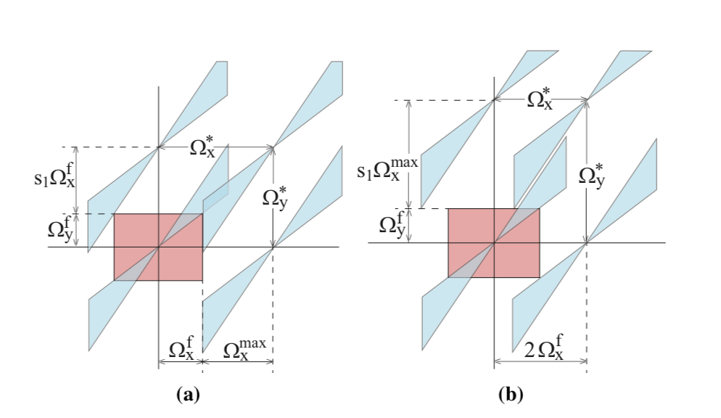
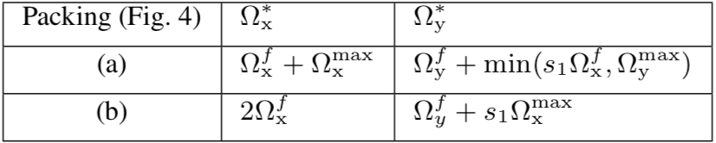
Adaptive sampling
To find smaller sampling rates
($Ω_{x}^{∗}×Ω_{y}^{∗})\left(a\right)−\text{(}Ω_{x}^{∗}×Ω_{y}^{∗})\left(b\right)=\text{(}Ω_{x}^{max}−Ω_{y}^{f})(Ω_{y}^{f}−s1Ω_{x}^{f})≤0$
http://cseweb.ucsd.edu/~viscomp/classes/cse274/fa18/papers/a163-mehta.pdf
Notes:
Because of non-idealities in smapling and reconstruction, including the use of Gaussian filter
We would like to increase the number of samples beyond the minimum required, just as in standard Monte Carlo rendering
To find the minimum sampling rates, we must pack the spectra such that adjacent copies do not overlap the axis-aligned filter to avoid aliasing error.
We can move the spectra along Omega x axis and Omega y axis, and there are two possible compact packings as shown.
Through computation, we just need smaller filter

Slide 20
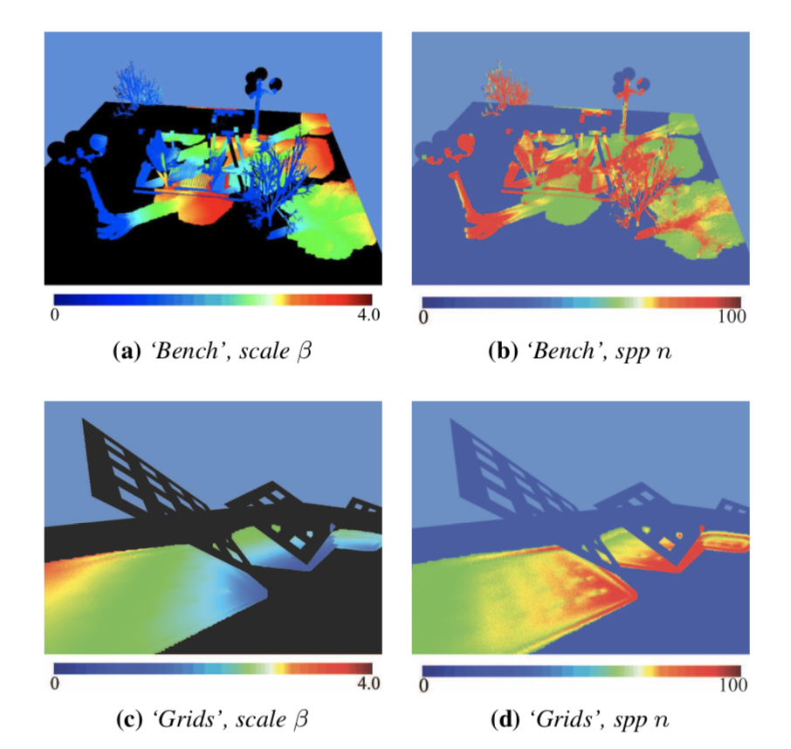

Adaptive sampling
Per-pixel sampling rates
$$n={(Ω_{x}^{∗})}^{2}{(Ω_{y}^{∗})}^{2}×A_{p}×A_{l}$$
http://cseweb.ucsd.edu/~viscomp/classes/cse274/fa18/papers/a163-mehta.pdf
Notes:
Extending 2D to 4D domain, the sampling rate is given by, Omega x square multiply Omega y square.
Here frequencies are in units of per meter, to convert this to samples per pixel n, we multiply by the area of the pixel Ap as well as the area of the lights source Al
Because the sampling rate depends on Omega x and Omega y, and is therefore spatially-varing
Finally we can see this picture, the left part (a) and (c) bench and grids scene shows the adaptive filter width with different beta. As we can see, shadows from close occluders can be sharper because smaller beta and should be filtered less, while those from further occluders can be filtered more
The right part (b) and (d) shows the adaptive samples per pixel. Notice more samples are needed in regions with smaller filter width

Slide 21
Overview
Introduction
Previous work
Methods
Axis-aligned filtering
Adaptive sampling
Results
Limitations
Contributions
Future work

Slide 22
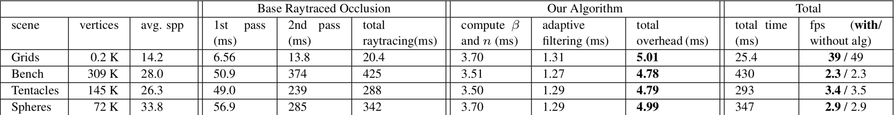
Results
Notes:
The author tested on different scenes of varying complexity
This is a table about details on the performance, in all cases, the average sampling rate is between 14 and 34, images with brute force ray tracing typically requires 150 to 200 samples
Adaptive filtering takes about 1.3
The time for determining the filter size and samples per pixel takes about 3.6 ms

Slide 23
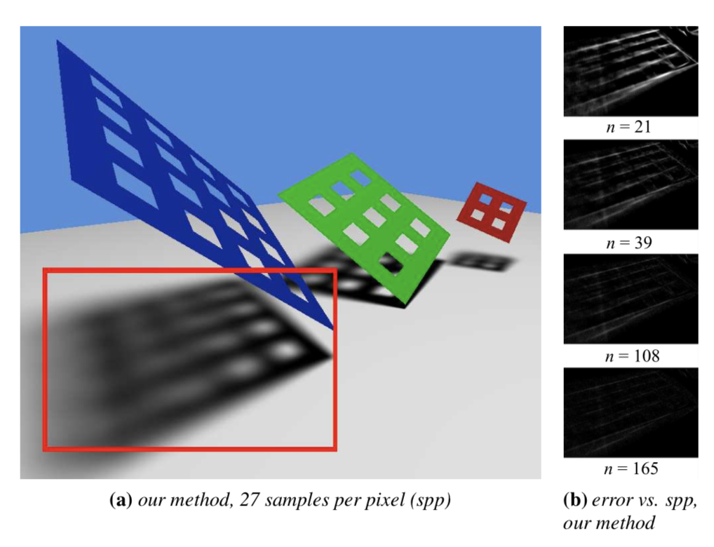
Results
http://cseweb.ucsd.edu/~viscomp/classes/cse274/fa18/papers/a163-mehta.pdf
Notes:
as in this Grids scene
The soft shadows are intricate
Part b shows scaled-up error images with respect to ground truth. The error are small and decrease rapidly with increasing sample count

Slide 24
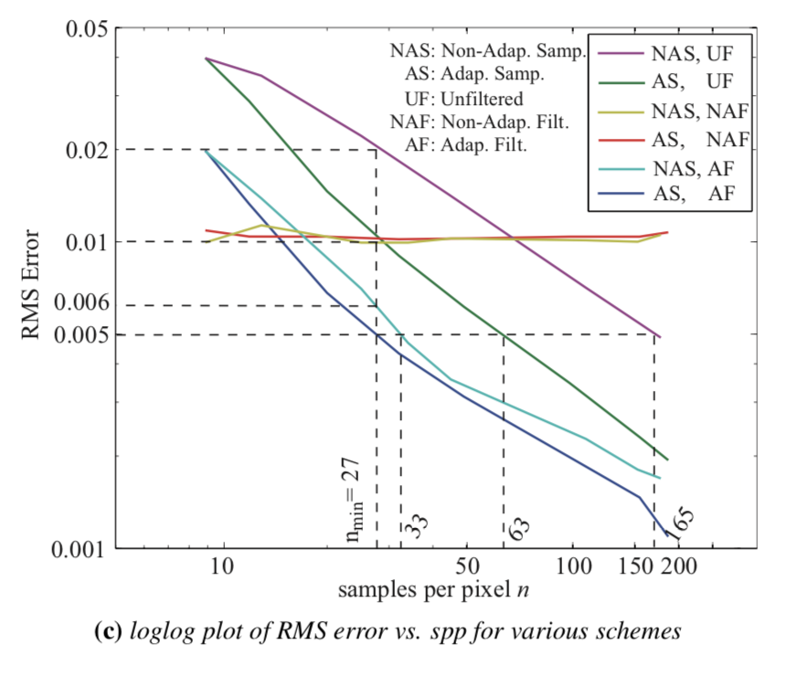
Results
http://cseweb.ucsd.edu/~viscomp/classes/cse274/fa18/papers/a163-mehta.pdf
Notes:
This is the result of various scheme combining unfiter or adaptive filter and sampling or adaptive sampling
They are standard Monte Carlo and adaptive sampling, both with unfilter , the adaptive sampling significantly reduces error
For two nearly constant line, Monte Carlo and adaptive sampling with fixed filter. The error remains flat
For both monte Carlo and adaptive sampling with adaptive filter, we can see the results are pretty good.

Slide 25
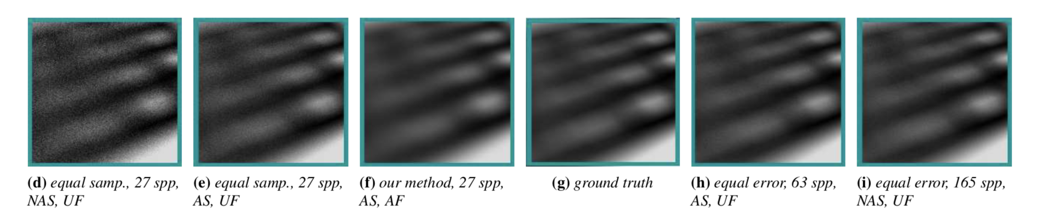
Results
http://cseweb.ucsd.edu/~viscomp/classes/cse274/fa18/papers/a163-mehta.pdf
Notes:
These plots corresponds previous plots, it shows equal sample and equal error comparisons for AS vs nAS and AF vs nF
For d and e no filter causes more noise
For h and I with equal error but needs more samples
This method does not need too many samples, but can converge to ground truth very quickly

Slide 26
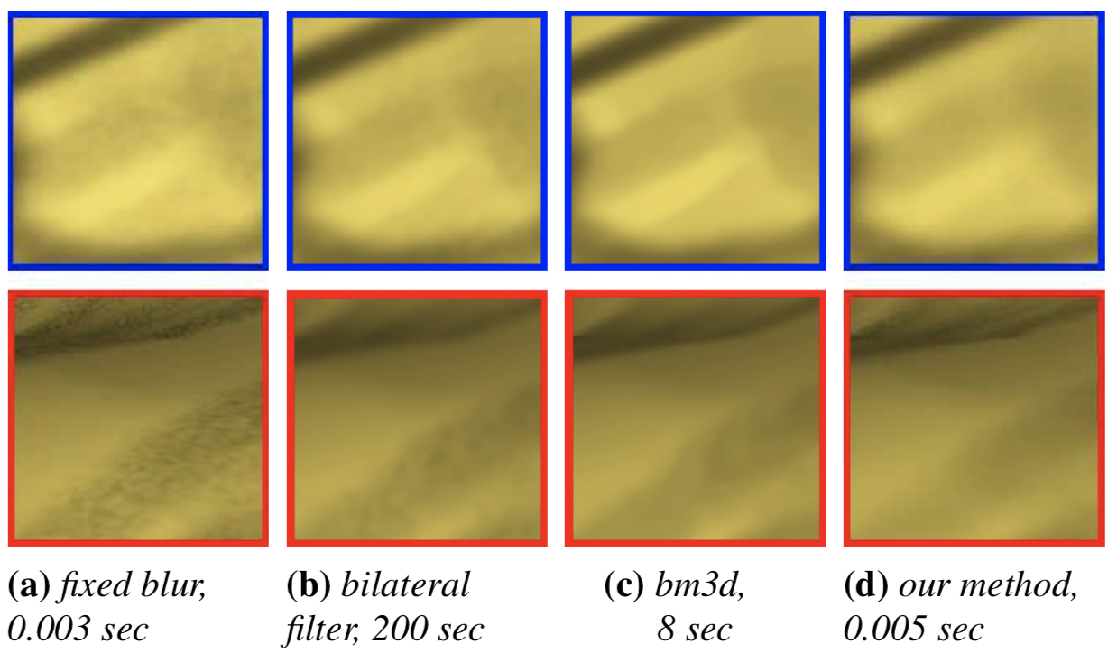
Results
Notes:
Comparison of accuracy and overheads of different denoising methods, all using the same 23 samples per pixel
Part (a) uses a constant kernel Gaussian filter, the overblurs contact shadow edges and remain some noise
Part (b) uses bilateral filter, it can’t remove noise effectively and is computationally expensive
Part (c) uses bm3d filter, it produces low frequency artifacts and takes longer
Also here is a video showing the result of different scenes achieving real time use
,besides moving viewpoint and light source, because no precomputation is required, it supports fully dynamic geometry

Slide 27
Overview
Introduction
Previous work
Methods
Axis-aligned filtering
Adaptive sampling
Results
Limitations
Contributions
Future work

Slide 28
Limitations
Slight overblur at some sharp shadow boundaries, and some flicker in video
Sample counts is still too high for real-time performance on very complex scenes
Notes:
The main limitation is that

Slide 29
Overview
Introduction
Previous work
Methods
Axis-aligned filtering
Adaptive sampling
Results
Limitations
Contributions
Future work

Slide 30
Contributions
Derivation of adaptive sampling rates
Adaptive filter sizes for axis-aligned pixel-light filtering of soft shadows
Notes:
The paper derive the adaptive sampling rates and adaptive filter sizes

Slide 31
Contributions
Consistent sampling, wherein the filter size is adjusted for the sampling rate
Ensuring convergences as in standard Monte Carlo
Notes:
Apply consistent sampling

Slide 32
Contributions
Simple implementation using Nvidia Optix
Real time interactive performance with minimal overhead
Notes:
Implements the algorithm using nvidia optix
achieve

Slide 33
Overview
Introduction
Previous work
Methods
Axis-aligned filtering
Adaptive sampling
Results
Limitations
Contributions
Future work

Slide 34
Future work
Similar methods to be employed for
— motion blur
— depth of field
— specularities
— indirect illumination
Notes:
Authors mentioned that they will apply the same method to other real time work like

Slide 35
Questions
Notes:
And any questions?

Slide 36


$$β\left(x\right)=\frac{1}{k}∗\frac{1}{μ}max⁡[\frac{1}{Ω_{L}^{max}}\left(\frac{d_{1}}{d_{2,max}}−1\right),\frac{1}{Ω_{x}^{max}}]$$
$$n=4(1+\frac{s_{1}}{s_{2}})^{2}({\frac{2}{s_{2}}\sqrt{\frac{A_{p}}{A_{l}}}+α({1+s_{2})}^{−1})}^{2}$$

